Slide 1

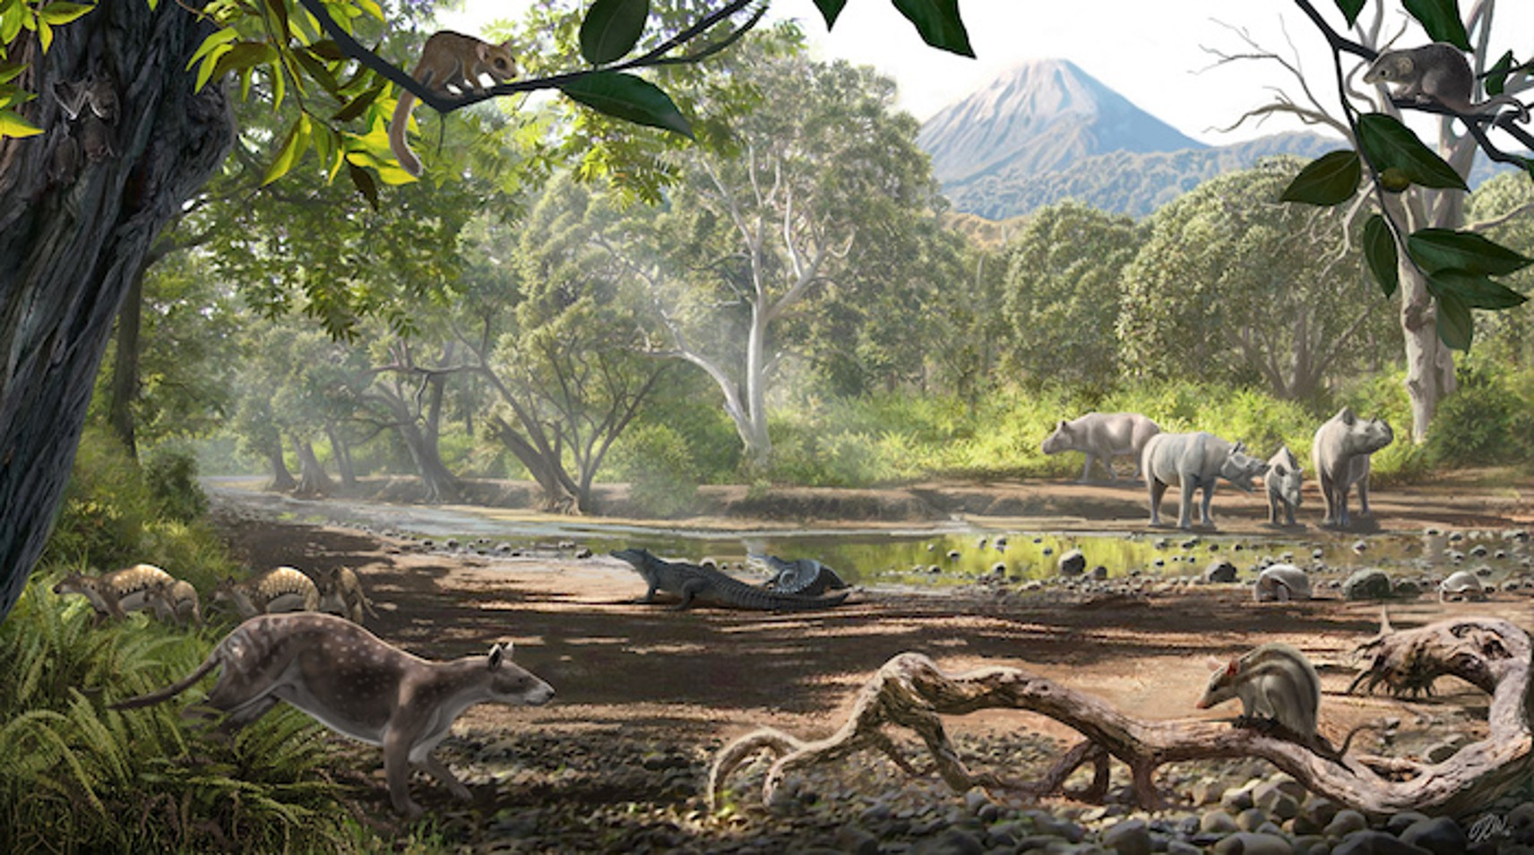

Apex Thinkers

Slide 2
Members
Naman Acharya – Leader
Nimanshu Panthi – Member
Sanchit Pacchai – Member
Anush Chhetri Puri – Member
Mossahid Khan – Member
Apex Thinkers

Slide 3
Apex Thinkers
Members
Naman Acharya – Leader
Nimanshu Panthi – Member
Sanchit Pacchai – Member
Anush Chhetri Puri – Member
Mossahid Khan – Member
Replitia
Mammalia
Aves
Apex Thinkers / Science Group Project
Visit www.hamro.vercel.app for viewing this presentation

Slide 4
Animals & Their Classes
Why Classify?
There are over 8 million animal species on Earth. If we didn’t group them, studying them would be a nightmare. So, scientists sort animals by what they have in common, known as Classification.
Reptilia
Aves
Mammalia
Apex Thinkers / Science Group Project
Visit www.hamro.vercel.app for viewing this presentation
Fun Fact: In 2022, over 18,000 new species were discovered. We’re still finding new ones!

Slide 5
Why Classify?
There are over 8 million animal species on Earth. If we didn’t group them, studying them would be a nightmare. So, scientists sort animals by what they have in common, known as Classification.
Covered in dry, rough scales.
Reptilia
Mammalia
They are Cold-Blooded, perhaps they need sun to warm up their body.
They lay eggs and breathe through lungs.
Fun Fact: In 2022, over 18,000 new species were discovered. We’re still finding new ones!
Most of them have a 3 chambered heart but crocodiles have 4 chambered heart.
Aves
Apex Thinkers / Science Group Project
Visit www.hamro.vercel.app for viewing this presentation

Slide 6
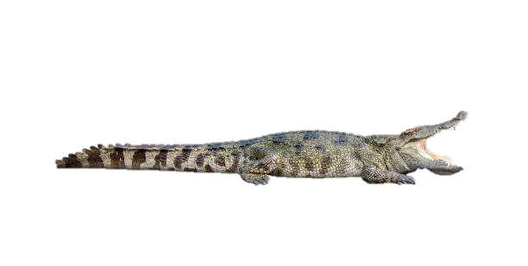
Reptilia
These are also called classic crawlers. Example of Reptilia are snakes, lizards, crocodiles, tortoises.
Covered in dry, rough scales.
They are Cold-Blooded, perhaps they need sun to warm up their body.
Crocodile watched the dinosaurs go extinct and just kept going. They have barely changed in 200 millions years.
They lay eggs and breathe through lungs.
Most of them have a 3 chambered heart but crocodiles have 4 chambered heart.

Slide 7
Replitia Fun Facts

Slide 8
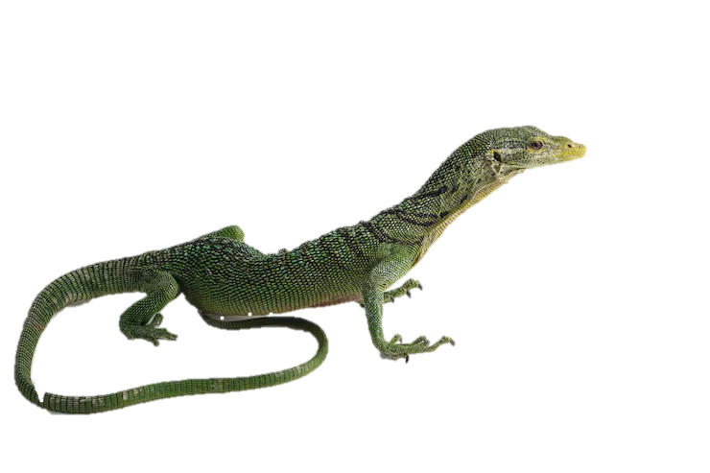
Reptilia Fun Facts
Crocodile watched the dinosaurs go extinct and just kept going. They have barely changed in 200 millions years.

Slide 9
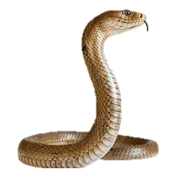
Reptilia Fun Facts
When a lizard is caught by its tail, it just separates its tail with its body and grows a new one.

Slide 10
Reptilia Fun Facts
They are warm blooded, so they can stay active in any whether.
Their front limbs became wings over millions of years.
Snakes have no eyelids. They sleep with their eyes open.
They have hollow bones. It might sound weak but it makes them lighter enough to fly.
They have 4 chambered heart just like us.

Slide 11
Aves
Aves are basically birds. Any animal with feathers belongs here.
They are warm blooded, so they can stay active in any whether.
Their front limbs became wings over millions of years.
They have hollow bones. It might sound weak but it makes them lighter enough to fly.
They have 4 chambered heart just like us.

Slide 12
Aves
Aves are basically birds. Any animal with feathers belongs here.
They are warm blooded, so they can stay active in any whether.
Their front limbs became wings over millions of years.
They have hollow bones. It might sound weak but it makes them lighter enough to fly.
They have 4 chambered heart just like us.

Slide 13
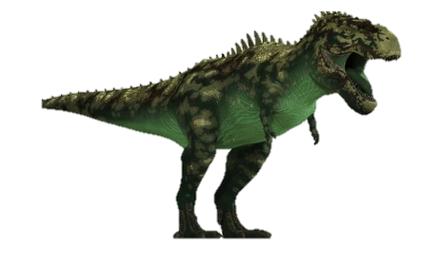

Slide 14
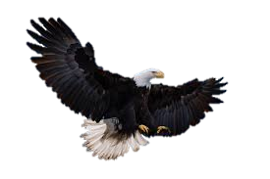
Aves Fun Fact
Birds are literally descended from dinosaurs. The pigeon outside? Dinosaur!

Slide 15
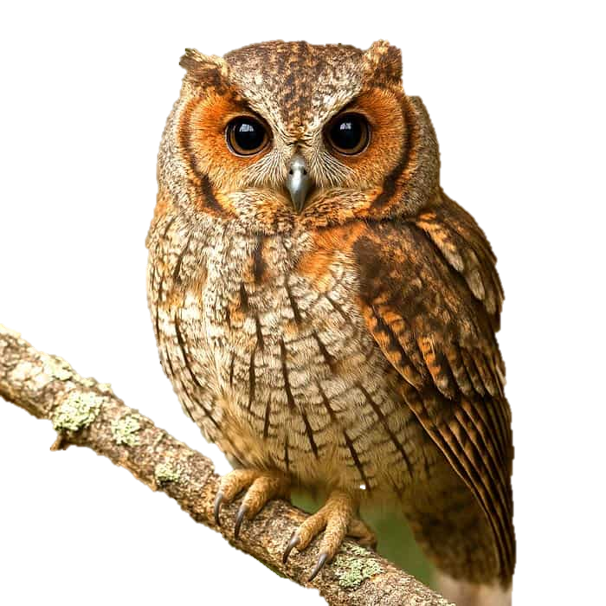
Aves Fun Fact
Their bones look fragile but hollow bones are actually stronger than solid ones at the same weight.

Slide 16
Aves Fun Fact
Owls can rotate their heads 270 degrees, almost all the way around! They do this because their eyes are fixed in their skull and can't move like humans.

Slide 17
Mammalia
Mammals are the most advanced animals on Earth. From tiny rats and bats to massive whales and even humans, we all fall under the same class
Their body is covered with hair or fur.
They have developed mammary glands, females produce milk for their young.
These animals are warm-blooded.
Fertilization is internal and they give birth to live young.

Slide 18
Mammalia
Mammals are the most advanced animals on Earth. From tiny rats and bats to massive whales and even humans, we all fall under the same class
Their body is covered with hair or fur.
They have developed mammary glands, females produce milk for their young.
These animals are warm-blooded.
Fertilization is internal and they give birth to live young.

Slide 19
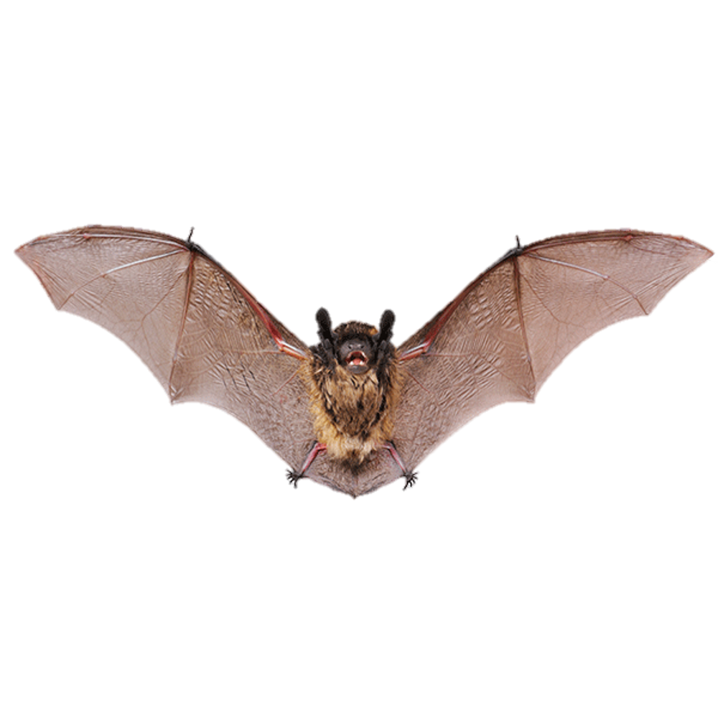

Slide 20
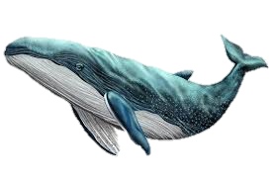
Mammalia Fun Fact
Bats are the only mammals that can truly fly

Slide 21
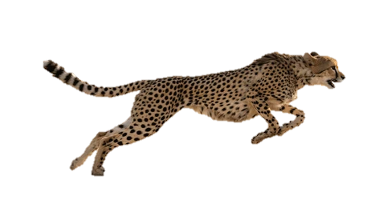
Mammalia Fun Fact
Whales are mammals living entirely underwater, yet they breathe through lungs and feed their babies with milk, just like land animals.

Slide 22

Mammalia Fun Fact
A cheetah can run at 120 km/h, the fastest land animal on Earth. But speed isn't what makes it a mammal. It's the hair on its body, the milk it feeds it’s cubs, and the four-chambered heart pumping inside its chest.

Slide 23
Mammalia Fun Fact
A cheetah can run at 120 km/h, the fastest land animal on Earth. But speed isn't what makes it a mammal. It's the hair on its body, the milk it feeds it’s cubs, and the four-chambered heart pumping inside its chest.

Slide 24


Slide 25

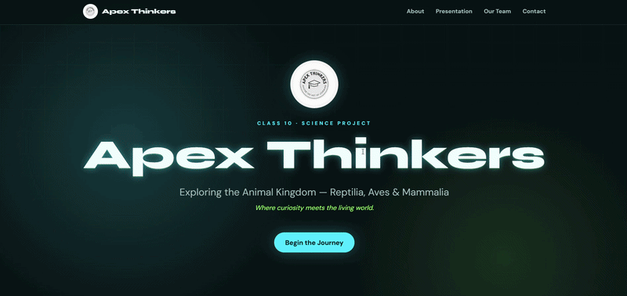

Visit Our Website!
Apex Thinkers / Science Group Project
Visit www.hamro.vercel.app for viewing this presentation

Slide 26
Apex Thinkers / Science Group Project
Visit www.hamro.vercel.app for viewing this presentation

